Slide 1
SIMPLEX METHOD

Slide 2
What Does Simplex Method Mean
The simplex method, in mathematical optimization, is a well-known algorithm used for linear programming.
It is a problem in which we have to find minimum or maximum value of linear objective function.
The simplex method presents an organized strategy for evaluating a feasible region's vertices. This helps to figure out the optimal value of the objective function.
The method is also known as the simplex algorithm.

Slide 3
The simplex method is used to eradicate the issues in linear programming.
It examines the feasible set's adjacent vertices in sequence to ensure that, at every new vertex, the objective function increases or is unaffected.
In general, the simplex method is extremely powerful, which usually takes 2m to 3m iterations at the most (here, m denotes the range of equality constraints), and it converges in anticipated polynomial time for specific distributions of random input.
The simplex method uses a systematic strategy to generate and test candidate vertex solutions to a linear program. At every iteration, it chooses the variable that can make the biggest modification toward the minimum solution. That variable then replaces one of its covariables, which is most drastically limiting it, thereby shifting the simplex method to another part of the solution set and toward the final solution.

Slide 4
Slack Variable
Slack variables are additional variables that are introduced into the linear constraints of a linear program to transform them from inequality constraints to equality constraints.
If the model is in standard form, the slack variables will always have a +1 coefficient.

Slide 5
Example
Max Z = 80X₁+55X₂
4x₁+2x₂<= 40
2x₁+4x₂<=32
and x₁, x₂ >=0

Slide 8
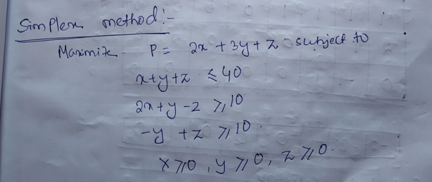

Slide 9
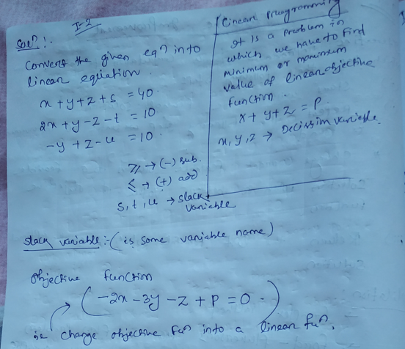

Slide 10
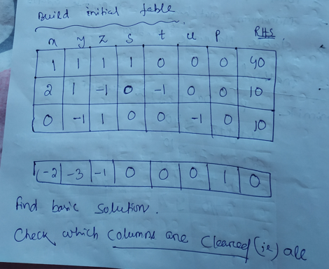

Slide 11
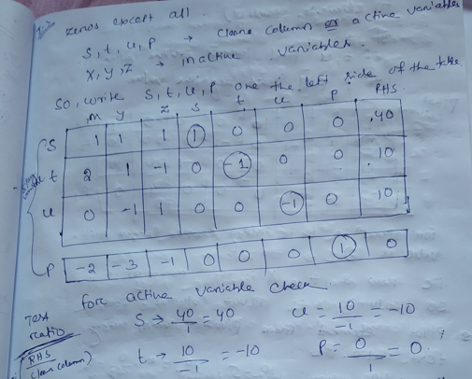

Slide 12
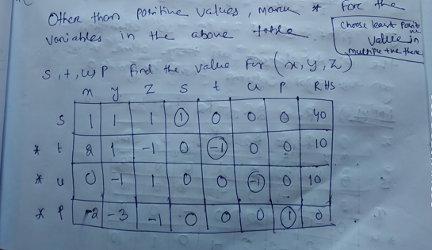

Slide 13
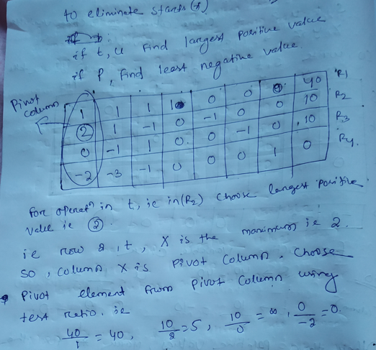

Slide 14
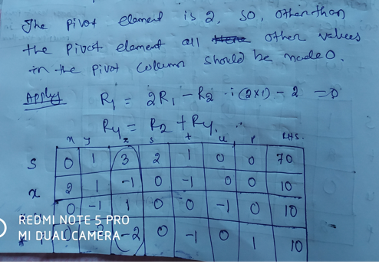

Slide 15
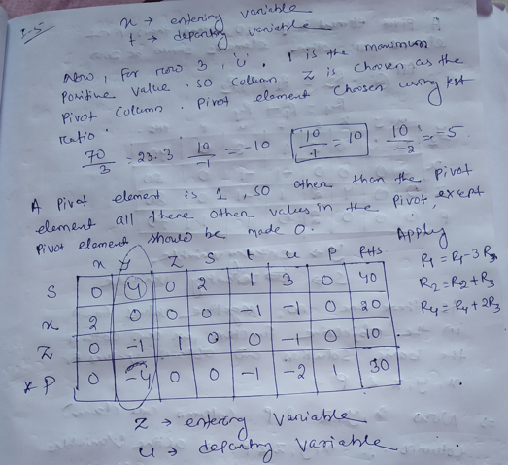

Slide 16
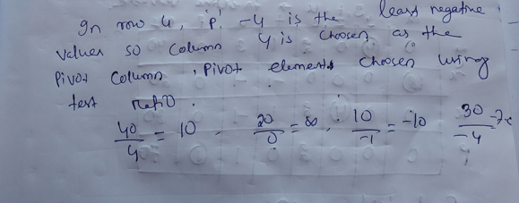

Slide 17
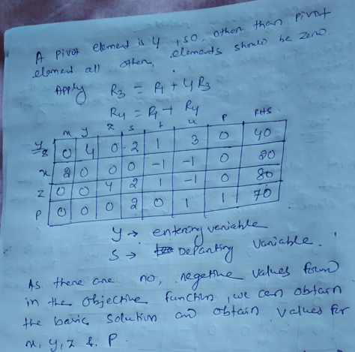

Slide 18
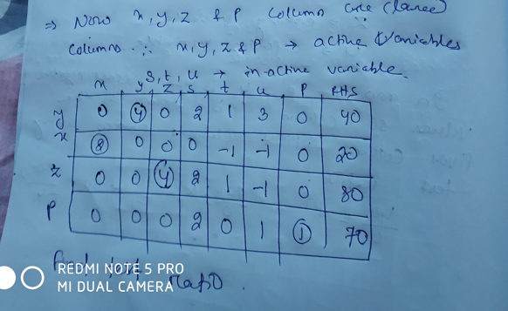

Slide 19
